Slide 1

Attendance

Slide 2
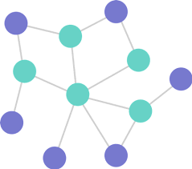

Graphs and Their Algorithms
Focusing on Python and C++ Implementations
Joshua Ganschow – Dakota State University
10/29/24

Slide 3
Introduction to Graphs
What is a graph?
A graph is a data structure consisting of:
Nodes (also known as vertices)
Edges (connections between the nodes)
Used to represent relationships, networks, paths, etc.

Slide 4
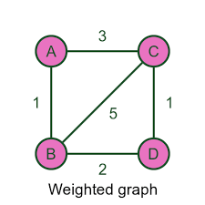
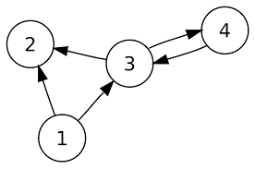
Types of Graphs
Directed vs Undirected
Directed: Edges have a direction (e.g., one-way streets)
Undirected: Edges are bidirectional (e.g., two-way roads)
Weighted vs Unweighted
Weighted: Edges have weights/costs (e.g., distance)
Unweighted: Edges are equal in weight/cost

Slide 5
How do We Represent These in Code?

Slide 6
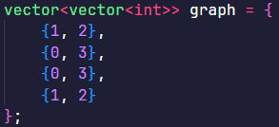
Adjacency List
Each node has a list of other nodes it is directly connected to
Works well for sparse graphs (fewer edges) as they will take up less space
Fast for iterating over connected nodes
Ideal for most competitive programming situations as they are quite efficient

Slide 7
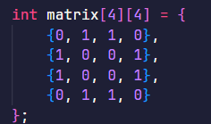

Adjacency Matrix
A 2D array where matrix[i][j] is 1 if an edge exists between nodes i and j, otherwise 0
Best for dense graphs (many edges)
Constant time to check if two nodes are connected
Less common in competitive programming solutions due to higher memory consumption

Slide 8
Choosing a Representation
Which representation suits my needs?

Slide 9
Adjacency List vs Adjacency Matrix
Adjacency list: efficient for sparse graphs where most nodes have few connections
Pros: saves memory, better for edge-centric operations like DFS/BFS (will go over these later)
Cons: slightly slower for edge presence checks between two specific nodes
Adjacency matrix: suited for dense graphs where many nodes are interconnected
Pros: constant-time edge lookups (just need to check if matrix[i][j] exists), easy to implement for small graphs
Cons: high memory usage, especially for large, sparse graphs

Slide 10
Choosing Based on Problem Constraints
Graph size: if the graph has thousands of nodes/edges, lean toward adjacency lists to avoid memory limits
Edge Queries vs Traversal
For quick edge presence checks between nodes, an adjacency matrix will be more efficient (in general)
For traversing connected nodes (common in DFS/BFS), adjacency lists will generally perform better

Slide 11
Examples of Representation Choice in Contests
Adjacency List
Adjacency Matrix
Pathfinding
Connected components
Cycle detection
Dense networks
Floyd-Warshall for all-pairs shortest paths

Slide 12
Algorithm Time

Slide 13
Depth-First Search (DFS)
For traversing graphs

Slide 14
What is DFS?
DFS is a traversal technique that explores as far as possible along each branch before backtracking
Traverses one path until the end, then backtracks
Useful for problems involving pathfinding, detecting cycles, finding connected components, and exploring all possible paths

Slide 15
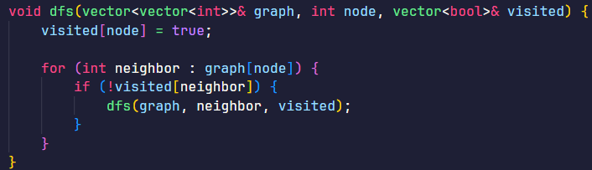
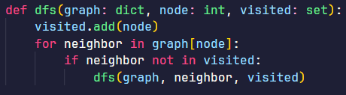
How DFS Works
Recursive approach: DFS can be implemented recursively by calling the function on each unvisited node
Iterative approach: Alternatively, use a stack to simulate the recursion for environments with limited stack depth

Slide 16
Applications in Competitive Programming
Cycle detection: determine if a graph has a cycle
Connected Components: count the number of isolated subgraphs
Pathfinding: find if there is a path from a source to a destination in a graph

Slide 17
Time and Space Complexity
Time complexity: O(V+E), where V is the number of vertices and E is the number of edges
Space complexity: Depends on recursion depth, can be O(V) for stack/recursive calls

Slide 18
Breadth-First Search (BFS)
Also for traversing graphs

Slide 19
What is BFS?
BFS is a traversal technique that explores nodes level-by-level, visiting all neighbors of a node before moving to the next layer
Traverses breadth-first (layer by layer from the starting node)
Useful for finding the shortest path in unweighted graphs, detected connected components, and exploring all nodes within a specific “distance” from a starting node

Slide 20
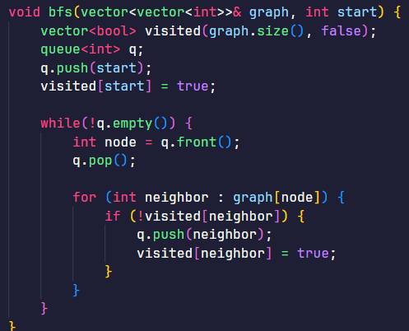
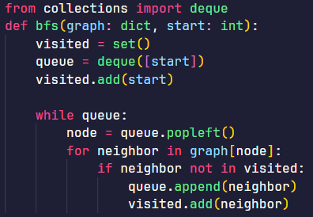
How BFS Works
Queue-based approach: BFS uses a queue to keep track of nodes to visit next, ensuring that nodes are processed in a first-in, first-out (FIFO) order
Each node’s neighbors are explored fully before moving to the next level of nodes

Slide 21
Applications in Competitive Programming
Shortest path in Unweighted Graphs: BFS guarantees the shortest path from the source to any reachable node in unweighted graphs
Connected Components
Flood fill and similar algorithms: ideal for filling areas or checking connectivity in grids

Slide 22
Time and Space Complexity
Time complexity: same as DFS
Space complexity: O(V) for the queue and visited tracking

Slide 23
Minimum Spanning Tree
Finding the MST of weighted graphs

Slide 24
What is an MST?
An MST is a subset of edges in a weighted, connected graph that connects all vertices with the minimum possible total edge weight and no cycles
Properties:
Spans all nodes
No cycles (needs to be a tree)
Minimum weight (sum of edge weights is minimized)

Slide 25
Key Algorithms for MST
Prim’s Algorithm
Greedy algorithm that grows the MST one edge at a time, starting from an arbitrary node
Best for dense graphs
Time complexity: O((V+E)logV) with priority queue
Kruskal’s Algorithm
Greedy algorithm that sorts all edges by weight and adds edges to the MST if they don’t form a cycle
Best for sparse graphs
Time complexity: O(ElogE), primarily from sorting edges
Both of these algorithms will reveal the same MST for a given graph

Slide 26
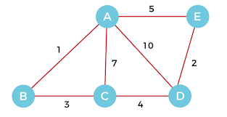

Slide 27
Applications in Competitive Programming
Network design: minimizing costs in networking, road systems, or power grids
Connectivity problems: ensuring minimum connections in graphs with costs

Slide 28
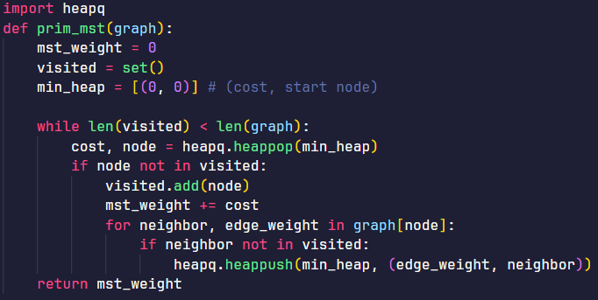
Quick Code Example

Slide 29
Other Common Algorithms

Slide 30
Dijkstra’s Algorithm
Finds the shortest path from a single source to all other nodes in a graph with non-negative weights
Complexity O((V+E)logV) using a priority queue
Commonly used for pathfinding in maps, routing, and navigation systems
Example problem: Given a graph of cities with travel times, find the shortest time from a starting city to each other city.

Slide 31
Bellman-Ford Algorithm
Computes shortest paths from a single source to all other nodes, handling negative weights
O(V*E)
Commonly used for graphs with negative edges, detecting negative cycles (for arbitrage detection)
Example problem: find the shortest path in a graph where some edges may have negative weights, like a currency exchange network

Slide 32
Floyd-Warshall Algorithm
Finds the shortest path between all pairs of nodes
O(V^3), only suitable for small to medium sized graphs
Commonly used for applications required all-pairs distance data, like network analysis
Example problem: calculate the shortest travel time between all city pairs in a given network

Slide 33
Union-Find (Disjoint Set Union)
Manages a set of elements partitioned into non-overlapping subsets, allowing efficient union and find operations
Complexity: almost constant (not really though but that a topic for another day)
Commonly used for detecting cycles in undirected graphs and dynamic connectivity queries
Example problem: check if adding an edge between two nodes in a graph would form a cycle

Slide 34
Graph Algorithm Challenges in Contests
Challenges and Tips for Graph Problems in Competitive Programming Contests

Slide 35
Recognizing Graph Problems
Problem Description: https://open.kattis.com/problems/secretchamber
Context: Historians uncover coded documents in a hidden chamber at Mount Rushmore. Using a list of letter translations, the task is to determine if each pair of words can match by applying the translations.
Objective: verify if word pairs match under given translation rules
Rules:
Words match if they have the same length.
Each letter in the first word can be transformed into the corresponding letter in the second word using the translations (applied zero or more times).

Slide 36
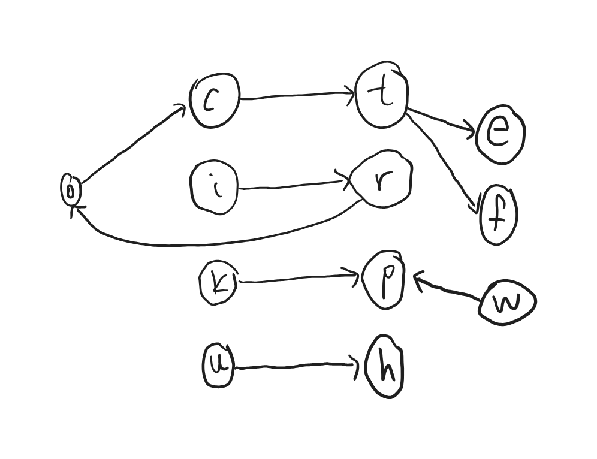
How is this a graph problem?
Each unique letter is a node, and a translation pair (e.g. a->b) is an edge
Checking if a letter in the first word can reach the corresponding letter in the second word is as simple as seeing if they are connected on the graph using DFS or BFS.

Slide 37
Recognizing Graph Problems
The following characteristics are typical of graph problems
Nodes/entities with relationships (e.g., cities with roads, people with connections, letters with transformations)
Reachability or connectivity questions (can one entity reach another?)
Pathfinding requirements (what is the shortest or any path between entities?)
Cycles or connected components (are there loops or isolated clusters?)
Keywords like “reachable,” “connected,” “transformation,” and “shortest path” can hint at a graph-based solution.

Slide 38
Time Complexity and Optimization
Graph Size constraints: consider problem constraints – large graphs require efficient algorithms to stay within time limits
Techniques for optimization:
Use efficient data structures (e.g., priority queue for Prim’s)
Avoid unnecessary recalculations and minimize memory usage

Slide 39
Graph Input Parsing
Standard input formats: the ones we talked about
Edge weights: be cautious of input format in weighted graphs (e.g., edge list with weights) and ensure all data is properly captured
In python, use `input().split()` for quick parsing
In C++, use scanf or cin with `std::ios_base::sync_with_stdio(false)` for speed

Slide 40
Common Pitfalls and Edge Cases
Disconnected graphs: ensure algorithms handle multiple components if the graph is disconnected
Self-loops and multiple edges: check if the graph has self-loops or multiple edges, these could throw off algorithms like MSTs
For algorithms that rely on acyclic properties, add checks to ensure cycles are managed correctly (e.g., using a set of visited nodes in DFS and BFS)

Slide 41
Practice Tips
Create templates for DFS, BFS, MST, etc., to save time during contests
Recognize problem patterns that fit typical algorithms (e.g., shortest path, connectivity, MST)
Always test your solution with edge cases, such as single-node graphs, complete graphs, or graphs with no edges

Slide 42
Recommended Practice Problems
CSES.fi has an entire section on their problem set dedicated to graph algorithms
On open.kattis.com
“Single source shortest path, non-negative weights”
“Reachable Roads”
“Minimum Spanning Tree”
“All Pairs Shortest Path”

Slide 43
Any questions?

